Slide 1
INCLUSION = EMBRACING DIFFERENCE
DIVERSITY IN SQUASH AND RACKETBALL – CAN YOU ASSESS YOUR VENUE?
Inclusivity
Connecting
Collaborating
Community

Slide 2
EQUALITY, DIVERSITY & INCLSUION
Yorkshire Squash is committed to provide services and activities fairly and without discrimination, and to following the principles of equality of access and opportunity.
We will do our best to ensure that all sections of the community have the opportunity to participate in the game of squash, and we will endeavour to eliminate all forms of discrimination, harassment or other unfair treatment to players, coaches, volunteers, staff and clubs.
We aim to reach out to new communities, new players by working with our venues and our coaches to be equal, diverse and inclusive.
This document offers areas of thought to help venues and coaches. It is based on advise and work of both ES and other NGB’s.

Slide 3
EVERY DAY INCLUSION ITS ABOUT ALL OF US….
I AM A PLAYER – I WELCOME EVERYONE ON COURT TO HIT AND ENJOY OUR SPORT irrelevant of age, gender, colour, ability
BEING A COACH I WANT EVERYONE TO FEEL THE JOY AND PROGRESSION OF SQUASH AND RACKETBALL
AS MANAGER OF OUR CLUB, I WELCOME EVERYONE TO USE OUR FACILITIES
I WILL CONTACT NEW PLAYERS AND ARRANGE GAMES
I WILL SEEK OUT NEW COMMUNITIES NEW PLAYERS AND SCHOOLS TO OPEN UP OUR SPORT
I WILL OFFER SPECIAL DEALS ON GROUP ACTIVITIES TO ENGAGE NEW COMMUNITIES
AS CHAIRMAN, I NEED TO LEAD NEW AVENUES, OPEN OUR COURTS TO NEW PEOPLE
I WILL LISTEN TO WHAT IS WANTED IN OUR VENUE AND WELCOME DIVERSITY
I WILL WELCOME NEW AND EXISTING PLAYERS TO HELP THEM ENJOY OUR SPORTS

Slide 4
HOW green IS YOUR VENUE?
We are great
We are working on this
No plans yet
 | GENDER ( Female, They, Trans, Male) | AGE ( U11, 11-18, 18-30, 30-50, 65-80, 50-65) | RACE | DISABILITY ( Mental, Physical, Visible, Invisible)
Committee
Teams
Members
Work Force
Coaches
Volunteers

Slide 5
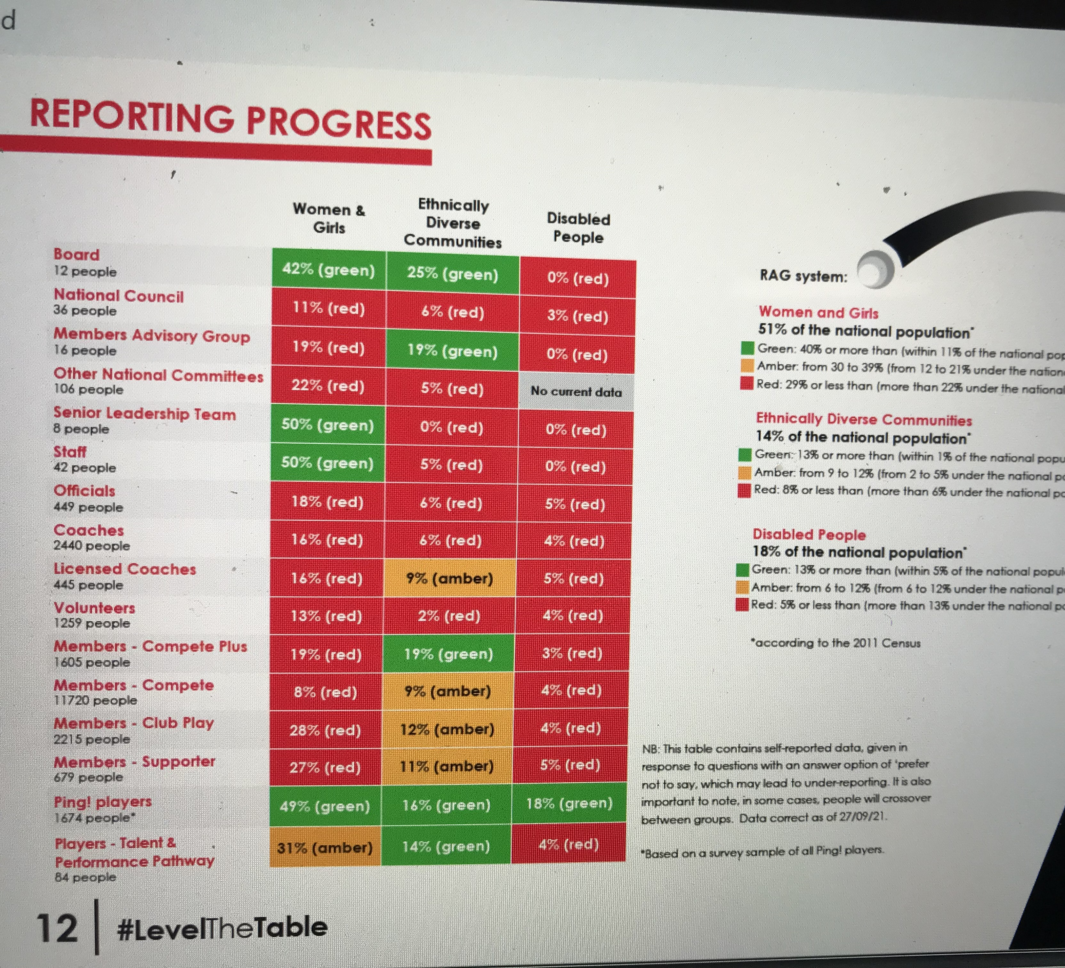
Where is YOUR Venue in this?
#LeveltheTable

Slide 6
WHAT CAN VENUES DO?
Invest time in thinking of diversity and inclusion
Highlight diversity thinking in your club through posters
Consider diversity in your committee and management meetings
Invest in programmes to drive diversity and inclusion
Speak to YSRA to consider ideas for diversity and inclusion

Slide 7
What we can do as ysra to help you?
Highlight issues of Diversity on Social Media
Offer solutions to venues to help with diversity
England Squash https://www.englandsquash.com/rallytogether
Gender Equality Club Checklist
Access to Diversity Projects and Coaches
Listen & Advise clubs, players and coaches

Slide 8
INCLUSION = EMBRACING DIFFERENCE
DIVERSITY IN SQUASH AND RACKETBALL
Inclusivity
Connecting
Collaborating
Community

